Slide 1
Gender Neutral Language
Catherine DeJager
Notes:
15 slides, about 1 minute per slide

Slide 2
What is gender neutral language?
“language that avoids bias towards a particular sex or social gender.” (Wikipedia)
Notes:
Take this slide out?

Slide 3
Why use gender neutral language?
Avoid perpetuating gender stereotypes, including the “male as norm” stereotype
Make people feel welcome and included regardless of gender
Help people to have more inclusive attitudes about gender (Sapir-Whorf Hypothesis)
Avoid unnecessarily revealing gender (e.g., to keep someone anonymous or to keep the detail of their gender from distracting from the message)

Slide 4
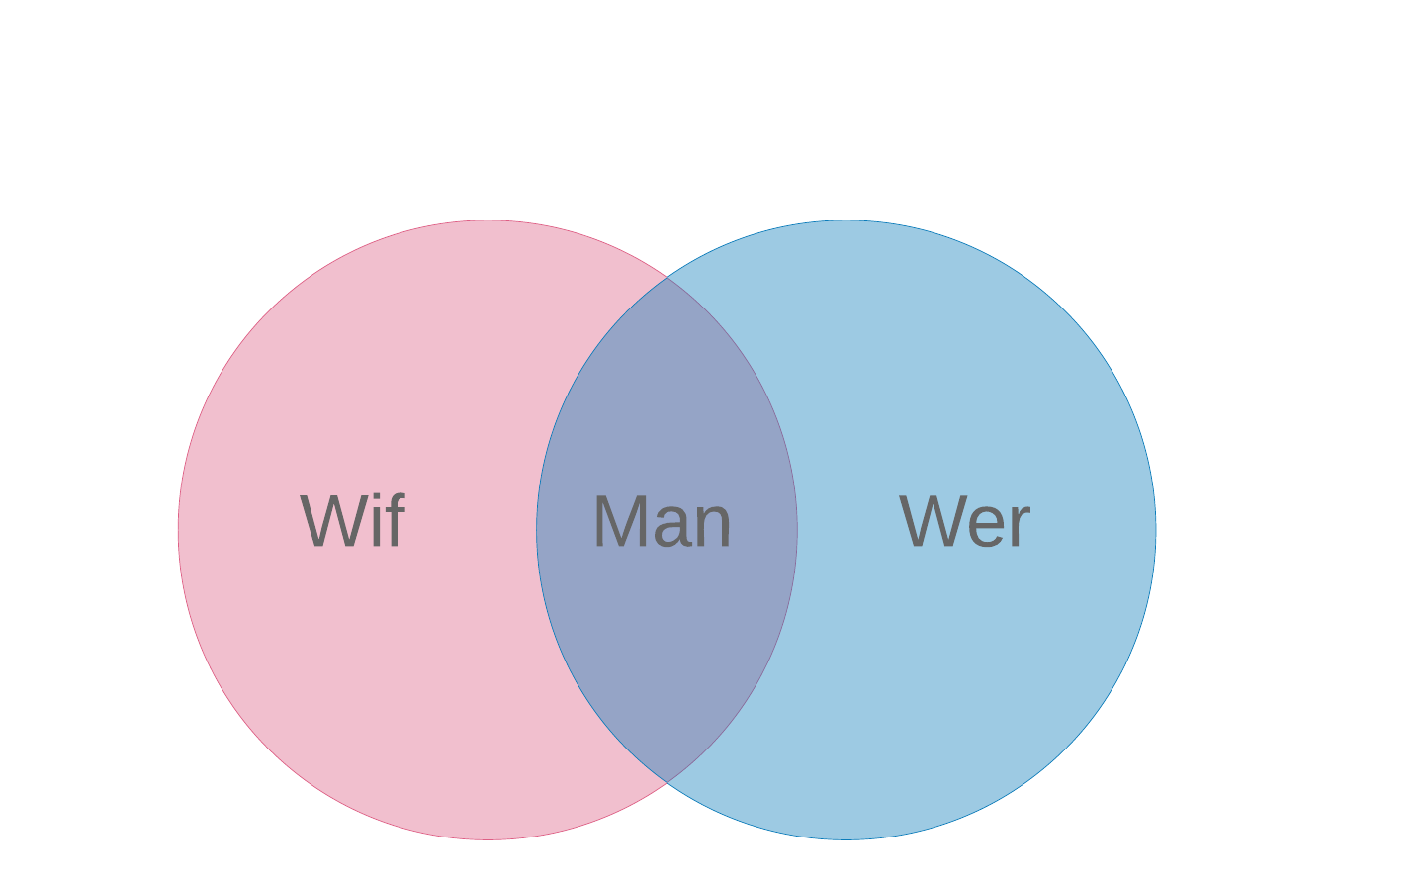
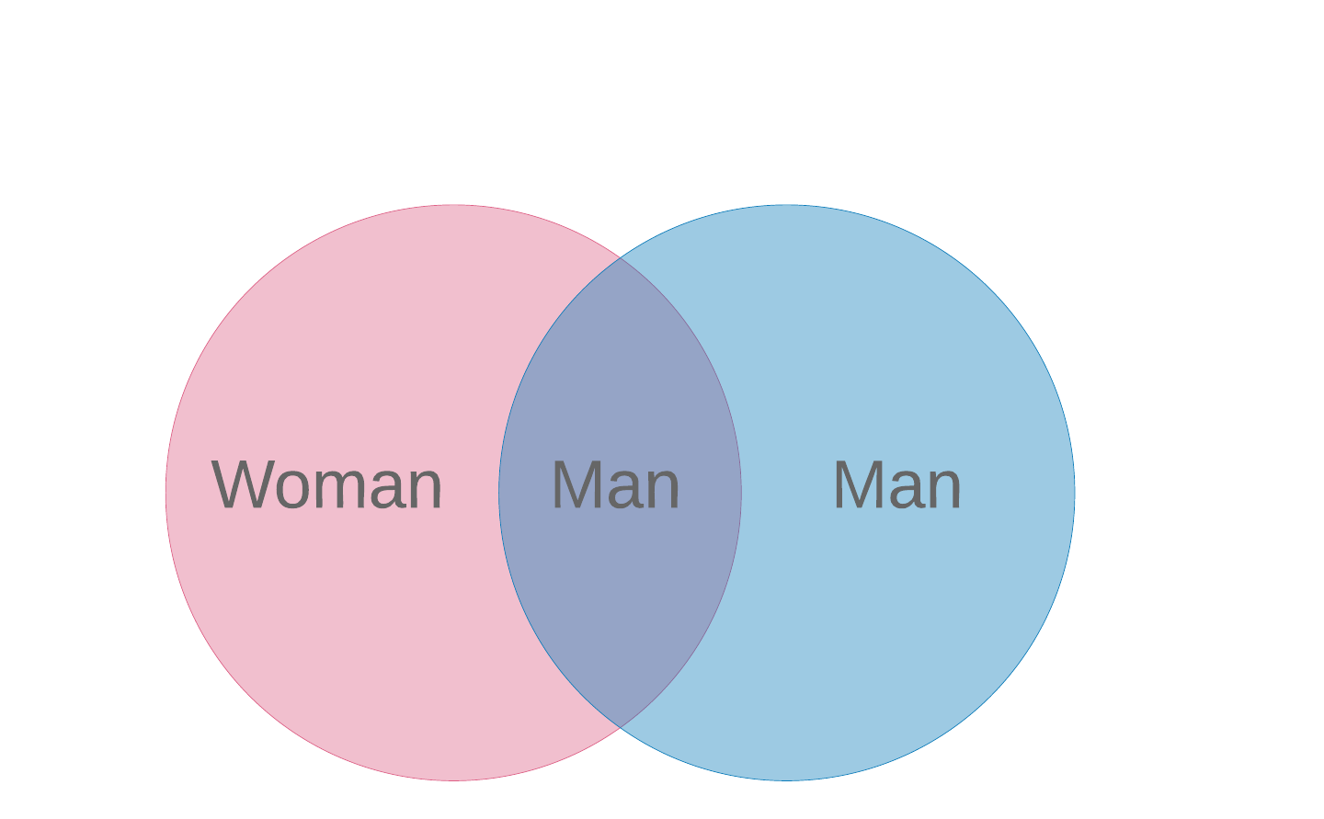
Man and wife
Notes:
“The man’s status as a person remains intact whereas the woman’s is changed from person to role” - Handbook of Nonsexist Writing
“In that tongue [Old English], man meant a human being of either sex, and wif and wer were the words for an adult female and male respectively. The parallel usage was somewhat analogous to the relative status of women and men in the society. Women had personal and property rights equal to those of men, and they worked at a wide variety of trades. By the end of the fifteenth century, the point marking the transition from Middle English to Modern English, women’s options had been greatly reduced and their rights curtailed under English common law. Their diminished status relative to men was symbolized in the growing exclusion of women from the very word men. Wer had by now dropped out of the language, though it survived in a few combinations like werewolf… Man and men were used increasingly for males only, leaving no unequivocal monosyllable that included members of both sexes.” - Words and Women
“Members of the women’s movement in France were arrested for displaying the slogan “One Frenchman in Two Is a Woman”; it was taken by some outraged French males to mean that 50 percent of their number were homosexuals” - Words and Women

Slide 5
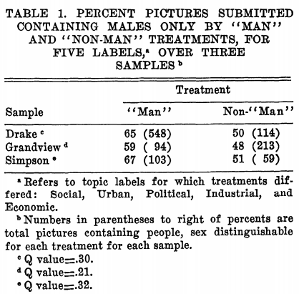
Sex Role Imagery and Use of the Generic "Man" in Introductory Texts: A Case in the Sociology of Sociology
Notes:
https://www.jstor.org/stable/27702068?seq=4#metadata_info_tab_contents (1973 study by sociologists at Drake University)
q values are p values adjusted to handle false positives of multiple tests

Slide 6
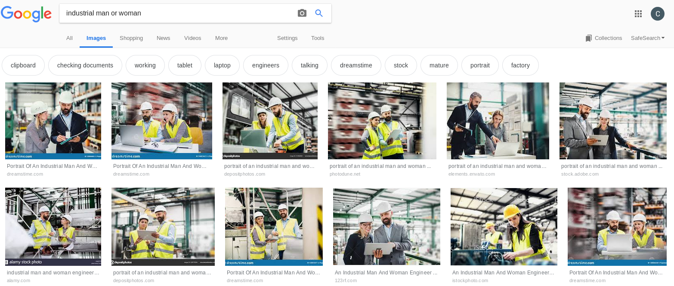

Slide 7
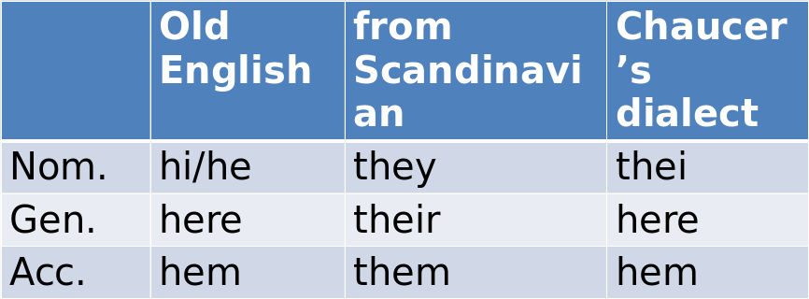
Middle English - they got new pronouns

Slide 8
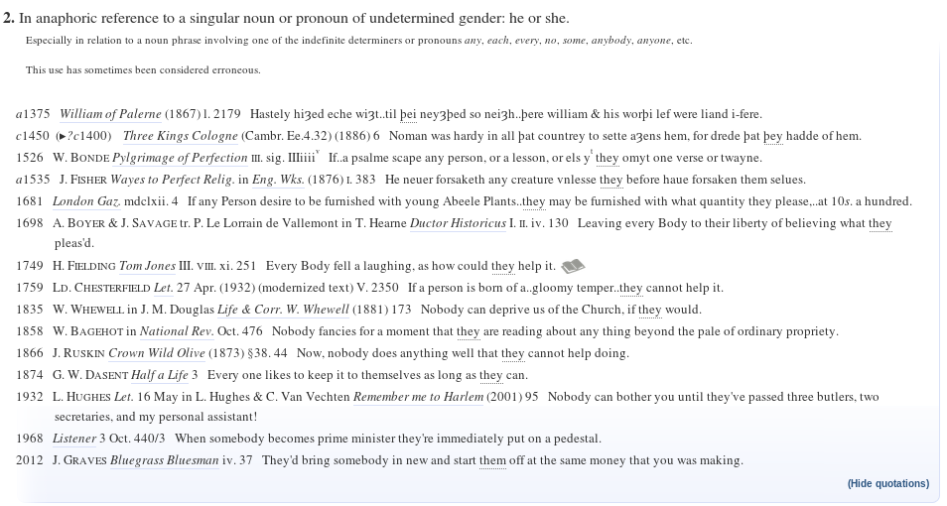
Middle English - they used these pronouns
Notes:
The word entered around 1200AD

Slide 9

Modern English - you say prescriptivist, I say prejudiced
“The Relative agrees with the Antecedent in gender, number and person… The Relative shall agree in gender with the Antecedent of the more worthy gender: as, the King and Queen whom I honor. The Masculine gender is more worthy than the feminine.” - Joshua Poole, grammarian, 1646
“The masculine Person answers to the general Name, which comprehends both Male and Female; as Any Person, who knows what he says.” - J. Kirby, “A New Grammar” (1746)
Notes:
Everything you ever wanted to know about singular they
4: Seeing Women and Girls as People - Masculinity, Femininity, and Other Sex-Linked Descriptives

Slide 10
Let’s make a new pronoun!
Ae (Lindsay, 1920)[58] | Ae is laughing | I called *aer* | *Aer* eyes gleam | That is *aers* | Ae likes *aerself*
E (Spivak, 1983)[59][60] | E is laughing | I called *Em* | *Eir* eyes gleam | That is *Eirs* | E likes *Emself*
Ey (Elverson, 1975)[61] | *Ey* is laughing | I called *em* | *Eir* eyes gleam | That is *eirs* | Ey likes *eirself*
Hou (Gom, 2017)[62] | *Hou* is laughing | I called *hee* | *Hy* eyes gleam | That is *hine* | Hou likes *hyself*
Hu (Humanist, 1982)[63] | *Hu* is laughing | I called *hum* | *Hus* eyes gleam | That is *hus* | Hu likes *humself*
Peh (Dicebox, 2012?)[64][65] | *Peh* is laughing | I called *pehm* | *Peh's* eyes gleam | That is *peh's* | Peh likes *pehself*
Per (Piercy, 1979)[66] | *Per* is laughing | I called *per* | *Per* eyes gleam | That is *pers* | Per likes *perself*
Thon (Converse, 1884)[67] | *Thon* is laughing | I called *thon* | *Thons* eyes gleam | That is *thons* | Thon likes *thonself*
Ve (Hulme, c. 1980)[68] | *Ve* is laughing | I called *ver* | *Vis* eyes gleam | That is *vis* | Ve likes *verself*
Xe (Rickter, c. 1973)[69] | *Xe* is laughing | I called *xem* | *Xyr* eyes gleam | That is *xyrs* | Xe likes *xemself*
Yo (regional, c. 2004)[70][71] | *Yo* is laughing | I called *yo* | — | — | ?
Ze, hir (Bornstein, n.d.)[72] | *Ze (Zie, Sie)* is laughing | I called *hir* | *Hir* eyes gleam | That is *hirs* | Ze (Zie, Sie) likes *hirself*
Ze, mer (Creel, 1997)[73] | *Ze* is laughing | I called *mer* | *Zer* eyes gleam | That is *zers* | Ze likes *zemself*
Ze, zir (unknown, c. 2013)[74] | *Ze (Zie, Sie)* is laughing | I called *zir/zem* | *Zir/Zes* eyes gleam | That is *zirs/zes* | Ze (Zie, Sie) likes *zirself/zemself*
Zhe (Foldvary, 2000)[75] | *Zhe* is laughing | I called *zhim* | *Zher* eyes gleam | That is *zhers* | Zhe likes *zhimself*
Notes:
From Wikipedia chart on 3rd person personal pronouns

Slide 11
Feminine noun endings
“-ess”
neighboress, singeress, servantess, dwelleress, sinneress, friendess and spousess (Wycliffe Bible, 1300s), herdess, charmeress, constabless and guideress (Chaucer)
“-ster”
Spinster, brewster, singster
“-trix”
admistratrixes, executrixes, mediatrixes (female mediators) and inheritrixes
Notes:
“Throughout its history, as English made the gradual change from grammatical to natural gender, words denoting occupations or professions could be and from time to time were used for females and males without distinction. But because males are consciously or unconsciously considered the norm, new feminine designations were introduced and accepted whenever the need was felt to assert male prerogatives. As the language itself documents, once certain occupations ceased to be women’s work and became trades or vocations in which men predominated, the old feminine-gender words were annexed by men and became appropriate male designations. Then new endings were assigned to women, quite possibly, in Fowler’s phrase, to keep a woman from “asserting her right” to a male’s name (or his job).” - Words and Women (Sex and Gender)

Slide 12
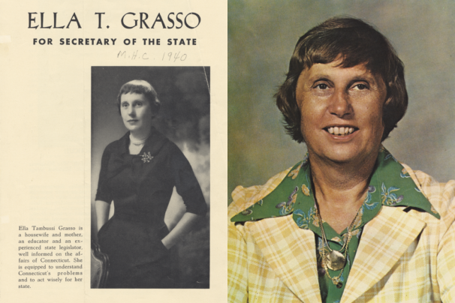
“Connecticut doesn’t need a governess”
Notes:
Campaign in 1974
Image source: http://dailynutmeg.com/wp-content/themes/Editorial/functions/thumb.php?src=wp-content/uploads/2017/11/EllaTGrasso_mashup_1200-1024x683.png&w=606&h=0&zc=1&q=90
Words and Women (Semantic Polarization)

Slide 13
What’s your title?
“What is manipulative is taking the original word ‘mistress’ and contracting it in two ways, ‘Mrs.’ and ‘Miss’, not for brevity but to indicate whether a woman is a possession or up for grabs” - poet Ann Sheldon, as cited in Words and Women
 | Male | Female, married | Female, unmarried | Female | Gender neutral
Title | Mr | Mrs | Miss | Ms | Mx
Year of introduction (according to OED) | 1449 | 1485 | 1667 | 1901 | 1977
Notes:
“Ms., which first appeared in secretarial handbooks in the 1940s” - Handbook of Nonsexist Writing
“Sometime in the late eighteenth century the social title Miss began to be used to distinguish single women from married women, and in the nineteenth century the custom developed of prefixing Mrs. to a man’s first and last name to identify his wife” - Handbook of Nonsexist Writing

Slide 14
Language about God
“But inevitably, when words like father and king are used to evoke the image of a personal God, at some level of consciousness it is a male image that takes hold. And since the same symbols are used of male human beings--from whom, out of analogy, the images of God have been drawn--female human beings become less God-like, less perfect, different, “the other.”” - Words and Women
“When women challenge the masculine linguistic symbols for God, what they are asking, among other things, is whether these metaphors do not encourage a double standard for evaluating human beings in addition to reinforcing an idolatrous concept of the deity.” - Words and Women
“We ought therefore to recall that God transcends the human distinction between the sexes. He is neither man nor woman: he is God.” - Pope John Paul, Catechism of the Catholic Church (article 239), 1992

Slide 15
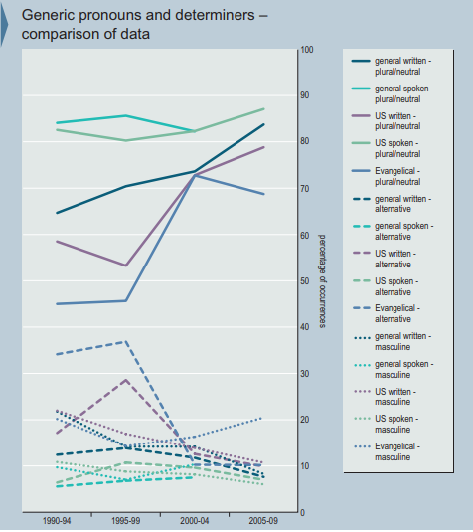
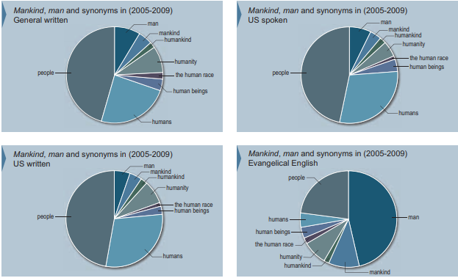
Collins Report (2010)
Notes:
“It is evident that, in all the varieties of English analyzed, plural/neutral pronouns and determiners account for the
majority of usages. Diachronically, the pattern is that plural/ neutral pronouns and determiners have become more
frequent since 1990; this increase is particularly marked in general and US written English and in Evangelical
English. There has been a slight decrease in gender-neutral uses since 2005 in Evangelical English, and a
corresponding increase in masculine uses, but gender-neutral pronouns and determiners are still over three
times more frequent than masculine ones in current Evangelical English.
The other main pattern is the decrease in alternative forms such as ‘him or her’, particularly in Evangelical English,
and also in US written English. These were quite frequent in the 90s in Evangelical English, particularly following
non-gender-specific nouns (a person, every child, etc.). However, in current Evangelical English they account for
only 10% of occurrences.”

Slide 16
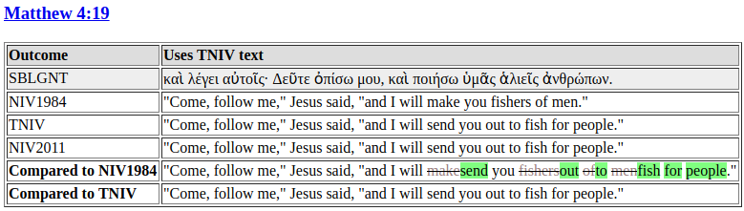
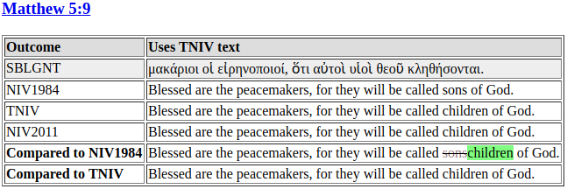
Notes:
People instead of men, children instead of sons (gender neutral nouns)
http://www.slowley.com/niv2011_comparison/Matthew.html

Slide 17
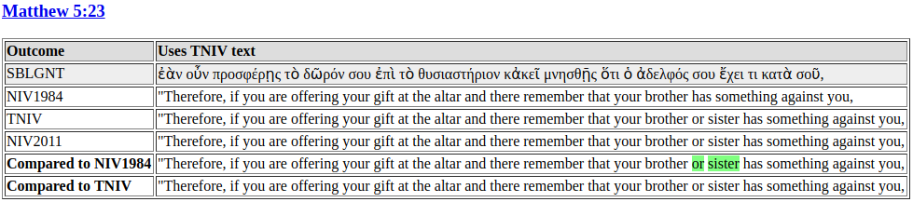
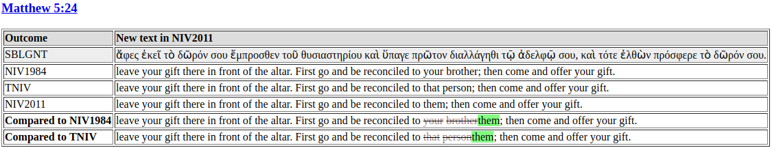
Notes:
Brother or sister instead of brother, them or that person instead of your brother (gender indication, singular they)

Slide 18
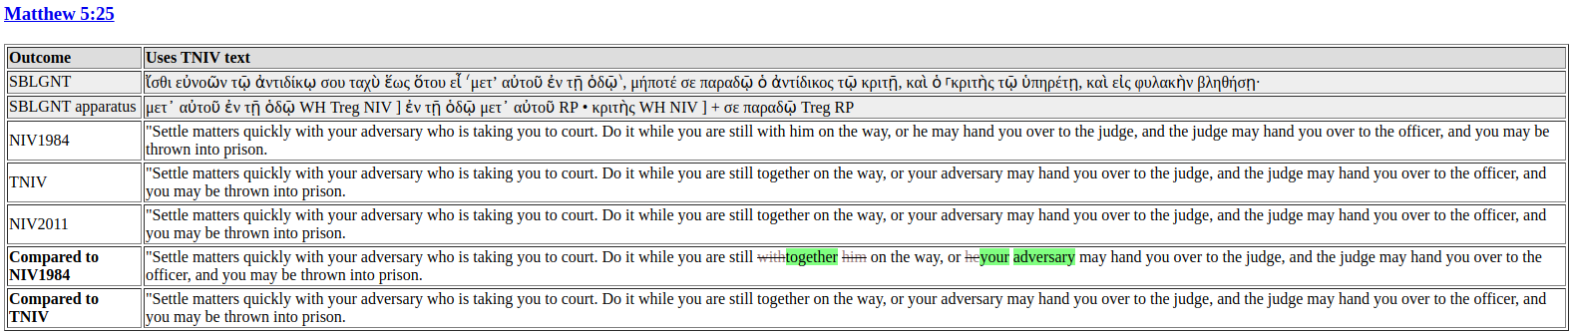
Notes:
together instead of with him, your adversary instead of he (removing pronouns, antecedent repetition)

Slide 19
How to make your language gender neutral
Use non-discriminatory language
Forms of address
Avoid expressions that reinforce gender stereotypes
Make gender visible when it is relevant for communication
Using feminine and masculine pronouns
Using two different words
Do not make gender visible when it is not relevant for communication
Use gender-neutral words
Using plural pronouns/adjectives
Use the pronoun one
Use the relative pronoun who
Use a plural antecedent
Omit the gendered word
Use the passive voice
Notes:
Taken from http://www.un.org/en/gender-inclusive-language/guidelines.shtml

Slide 20
How to make your language gender neutral
Use non-discriminatory language
Forms of address
Avoid gender-biased expressions or expressions that reinforce gender stereotypes
Less inclusive | More inclusive
“Professor Smith (surname and title for a man) and Madeline (first name for a woman) will attend the luncheon.” | “Professor Smith and Professor Jones will attend the luncheon (surname and title for both).”
Less inclusive | More inclusive
“Guests are cordially invited to attend with their wives.” | “Guests are cordially invited to attend with their partners.”
Discriminatory examples: “She throws/runs/fights like a girl”, “In a manly way.”, “Oh, that’s women’s work”
Notes:
Taken from http://www.un.org/en/gender-inclusive-language/guidelines.shtml

Slide 21
How to make your language gender neutral
Make gender visible when it is relevant for communication
Using feminine and masculine pronouns
Using two different words
“When a staff member accepts an offer of employment, he or she must be able to assume that the offer is duly authorized. To qualify for payment of the mobility incentive, she or he must have five years’ prior continuous service on a fixed-term or continuing appointment.”
“Boys and girls should attend the first cooking class with their parents.”
“All of the soldiers, both men and women, responded negatively to question 5 in the survey.”
Note: while language like this that indicates gender is explicitly inclusive of women, it is not inclusive of nonbinary people. Thus, you will want to consider the context of your audience to decide whether this language is appropriate.
Notes:
Taken from http://www.un.org/en/gender-inclusive-language/guidelines.shtml
Nonbinary

Slide 22
How to make your language gender neutral
Do not make gender visible when it is not relevant for communication
Use gender-neutral words (mankind -> humanity or people)
Using plural pronouns/adjectives
“Before submitting your document, send it to the focal point for their review; they will return it to you with comments.”
Use the pronoun one
“A staff member in Antarctica earns less than one in New York.”
Use the relative pronoun who
“A complainant who is not satisfied with the board’s decision can ask for a rehearing.”
Use a plural antecedent
“Substitute judges must certify that they have familiarized themselves with the record of the proceedings.”
Omit the gendered word
“A person must reside continuously in the Territory for 20 years before applying for permanent residence.”
Use the passive voice
“The author of a communication must have direct and reliable evidence of the situation being described.”
Notes:
Taken from http://www.un.org/en/gender-inclusive-language/guidelines.shtml

Slide 23
Sources
https://en.wikipedia.org/wiki/Gender_in_English
https://en.wikipedia.org/wiki/Gender-neutral_language
https://en.wikipedia.org/wiki/Gender_marking_in_job_titles
https://en.wikipedia.org/wiki/Third-person_pronoun
Words and Women - analysis of how language is used in ways that further oppression of women and suggestions for how to use language that promotes gender equality (Miller, C. & Swift, K. (1976))
The Handbook of Nonsexist Writing - style guide (Miller C. & Swift, K. (1980))
Chart taken from Professor Saupe’s Chapter 7 powerpoint
Oxford English Dictionary
Quotes from 17th-18th century grammarians about generic “he”: Everything you ever wanted to know about singular “they” (Stroppy Editor, Freeman, T. (2015))
Article on gendered nouns: You should basically stop using gendered nouns (The Washington Post, Fogarty, M. (2014))
Sex Role Imagery and Use of the Generic "Man" in Introductory Texts: A Case in the Sociology of Sociology (Drake University, Schneider, J. & Hacker, S. (1973))
Development and use of gender language in contemporary english: a corpus analysis [Collins Report] - full report at https://www.thenivbible.com/wp-content/uploads/2015/02/Collins-Report-Final.pdf, summary at https://www.biblica.com/articles/collins-report-gender-language-english/ (2010)
Comparison between NIV 1984, TNIV, and NIV 2011: http://www.slowley.com/niv2011_comparison/
Guidelines for gender-inclusive language in English (United Nations)
A History of the English Language (Baugh & Cable (2002))

Slide 24
Additional resources - effects of grammatical gender
From Mouth to Mind: How Language Governs Our Perceptions of Gender (Discover Magazine, Cottier, C. (2018))
The Gendering of Language: A Comparison of Gender Equality in Countries with Gendered, Natural Gender, and Genderless Languages (Prewitt-Freilino, J. & Caswell, T. & Laasko, E. (2011))
Linguistic relativity: Can gendered languages predict sexist attitudes? (Montclair State University, Thompson, A. (2014))
Masculine or Feminine and Why it Matters (Psychology Today, Jackson, S. (2012))
Sex, Syntax, and Semantics (MIT, Boroditsky, L., Scmidt, L. A., & Phillips, W. (2003))
Metaphorical Gender in English: Feminine Boats, Masculine Tools and Neuter Animals (Druide (2017))

Slide 25
Additional resources - pronouns
Androcentrism in Prescriptive Grammar: Singular 'They', Sex-Indefinite 'He', and 'He or She' (Rutgers University, Bodine, A. (1975))
A brief history of singular ‘they’ (Oxford English Dictionary Blog, Baron, D. (2018))
Gender Bias and Sexism in Language (University of Bologna, Menegatti, M. & Rubini, M. (2017))
Legistics - Singular "They" (Canada Department of Justice (2015))
A Linguist On the Story of Gendered Pronouns (The Toast, McCulloch, G. (2014))
The Politics of Grammar Handbooks: Generic He and Singular They (Zuber, S. & Reed, A. (1993))
Pronoun showdown 2016: Are nonbinary pronouns and singular they ruining the language or making English great again? (University of Illinois, Baron, D. (2016))
Singular “they” and the many reasons why it’s correct (University of California, Doyle, G. (2009))
Singular they is word of the year (The Web of Language, Baron, D. (2015))
Some notes on singular they (The Web of Language, Baron, D. (2015))
The Words that Failed: A chronology of early nonbinary pronouns (University of Illinois, Baron, D. (2016?))

Slide 26
Additional resources - other
The Conceptualization of Natural Gender in English (Anglophonia, Mignot, E. 2012)
Corpus analysis using TIME corpora and Corpus of Historical American English (COHA): corpora at https://www.english-corpora.org/, analysis at https://drive.google.com/open?id=1kYMAxZLh7wsDm0pHyoHzO46LxOcn1zl6VWhnelDn-1k
The Feminist Critique of Language: A Reader (Cameron, D. (1998))
Feminist Philosophy of Language (Stanford Encyclopedia of Philosophy Archive, Saul, J. & Diaz-Leon, L. (2004))
Gender-based language reform and the social construction of meaning (Discourse & Society, Ehrlich, S. & King, R. (1992))
Lexical inequities in marriage: Old English Wif, Wer, and Husbonda (Studia Neophilologica, Riedinger, A. (1994))
Semantics of gender marked nominations of person in english (Ad Atla: Journal of Interdisciplinary Research, Mariana, S. (2013))
Tweet like a girl: a corpus analysis of gendered language in social media (Yale University, Ott, M. (2016))
Casey Miller and Kate Swift: Women Who Dared To Disturb the Lexicon (Virginia Tech, Isele, E. (1994))
What Does “She” in Science Fiction Tell Us About Language on Earth? (Slate, McCulloch, G. (2014))
Women, fire, and dangerous things: what categories reveal about the mind (University of Chicago, Lakoff, G. (1987))

